Slide 1
Sigmathon v1.0
Topic:
Zomato Data Analysis
Team: Innov8
Team Members:
Siddharth Sinha, (sid3345@gmail.com)

Slide 2
Introduction
The commercial capital of Madhya Pradesh, Indore has another name as the “city of foodies”. This name has been given to Indore because of its Flavours, it’s variety of chats and the wide range of street foods.
Indore city prides itself on its food. People from all across the country have settled up here, particularly from Rajasthan, Maharashtra and UP. The number of restaurants in Indore are increasing day by day. Currently around 3900 restaurants in Indore are listed on Zomato. With each day new restaurants opening the industry hasn't been saturated yet and the demand is increasing day by day !
Despite increasing demand, it however has become difficult for new restaurants to compete with established restaurants. With such an overwhelming demand of restaurants it has therefore become important to study the demography of a location.
The key issues that continue to pose a challenge to them include high real estate costs, rising food costs, shortage of quality manpower, fragmented supply chain and over-licensing. With data analytics, the project also will help people in choosing the restaurant based on several factors.
This project will help new restaurants in deciding their theme, menus, cuisine, cost, locality, etc for a particular location.
“Just so that you have a good meal the next time you step out”

Slide 3
Objective
The basic objective of analyzing the Zomato dataset is to gather insights about the factors affecting the establishment of different types of restaurant at different places in Indore.
This project aims at exploring demography, consumer behaviour, and food culture of the city. And what factors should be kept in mind if someone wants to open new restaurant.
Some of the factors analysed in the projects are:
Restaurant Distribution over locality
Aggregate Rating per Locality
Cuisine trend per Locality
Top Dish liked per Locality
Service types popular in Indore
Restaurant Types popular in Indore
How many restaurants have online order service & book table service?
How the online order service affects the restaurant rating?
Which are some of the best restaurants providing online order?
How the book table service affects the restaurant rate?
Which are some of the best restaurants providing book table service??
Average Rating according to restaurant service
Characteristics of restaurants with online order service
What is the relation between cost and neighbourhood?
What is the relation between votes and neighbourhood?
What is the relation between meal type and locality?
What is the relation between meal type and the rating?
Best rated, most voted restaurants, irrespective of cost
Best restaurants in Indore ?
Where can one find the best restaurants in Indore?
Average cost at this overall best restaurants?
Top 10 restaurant chain in Indore
Top restaurant service types in Indore
Distribution of aggregate_rating
Probablity distribution of average_cost

Slide 4
Notebook and Dataset Description
Dataset collected from Zomato consists of features:
'name',
'locality',
'latitude',
'longitude',
'cuisines',
'average_cost',
'aggregate_rating',
'votes',
'rating_text',
'online_order',
'book_table',
'rest_type',
'dish_liked',
'meal_type',
'reviews_text'
Main categories of the notebook are:
Initial Setup
Data Cleaning
Getting Insights through Data Visualization
HeatMap
Word Analysis
Predictions

Slide 5
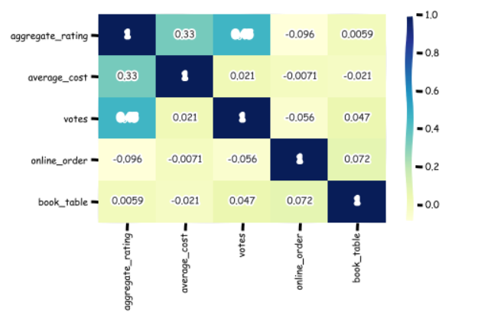
Co-relation
Votes and aggregate_rating has relatively higher co-relation, followed by average_cost and aggregate_rating.
Online_order has small negative co-relation with aggregate_rating, average_cost and votes.
Book_table has almost no co-relation with aggregate_rating, average_cost, votes and online_order.
Thus it seems, book_table service can be eliminated, without any effect on rating, votes, and cost

Slide 6
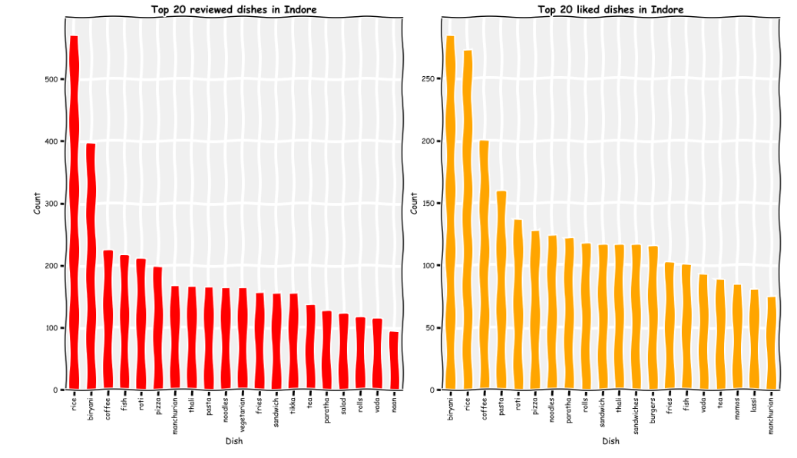
Top 20 dish liked and reviewed dish in Indore

Slide 7
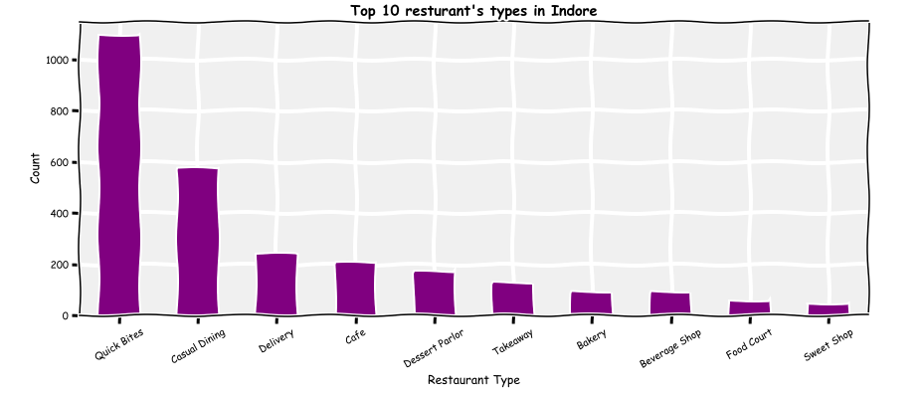
Top restaurants type in Indore
Quick Bites is the most common restaurant type in Indore, followed by Casual Dining.
Business wise, one should be careful before going into Quick Bites restaurants as more than 1000 restaurants serve in this category !

Slide 8
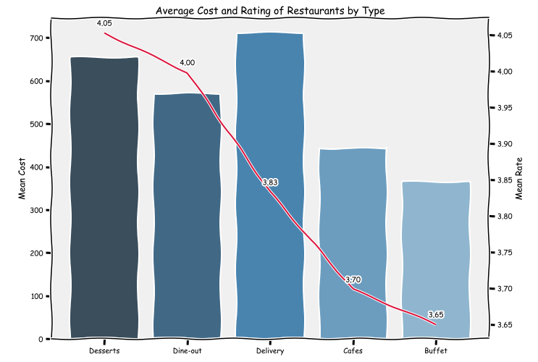
Average Cost and Rating for each restaurant type
Desserts have high mean cost, but also highest rating, followed by dine-out.
So, generally high cost restaurants tend to have higher ratings also.

Slide 9
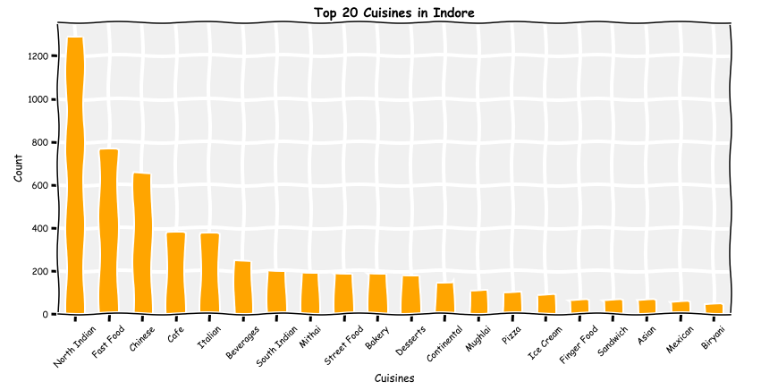
Top 20 cuisines in Indore
As we can notice from the above chart that North indian is at the top of cuisines provided in Indore, followed by Fast Food and Chinese.

Slide 10
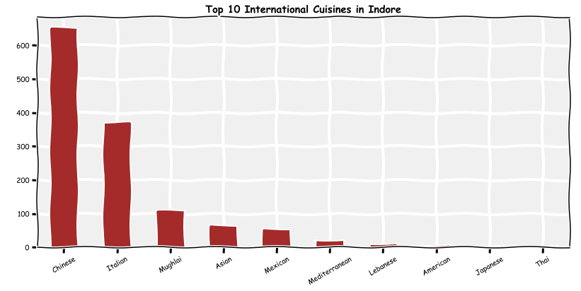
top international cuisines
Chinese at the top, followed by Italian then Mughlai.
We can see different cultures from all over the world like Italian ,Asian , Mexican, Mediterranean and Mughlai
Highly diversified market

Slide 11
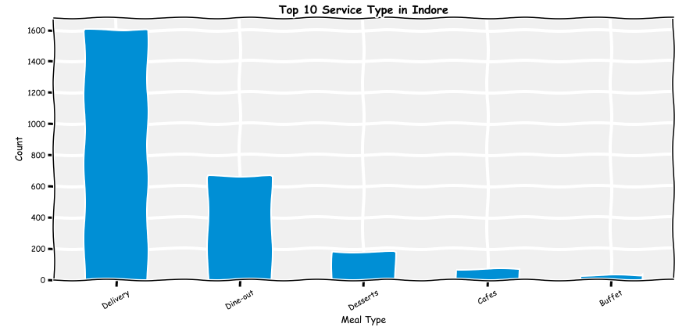
Top restaurant service types in Indore
Delivery meal_types is highest in Indore, followed by Dine-out and Desserts.

Slide 12
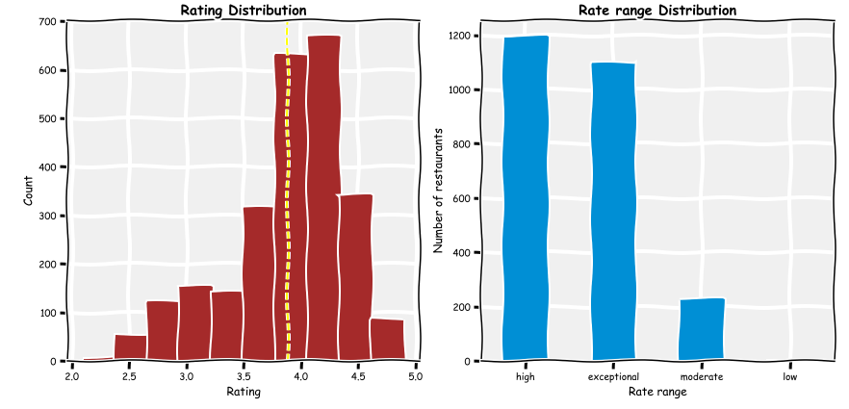
Distribution of aggregate_rating
As we notice here that it's almost normal distribution with average at 3.8
The majority of restaurants rated between 3.5 and 4.5 (High range)

Slide 13
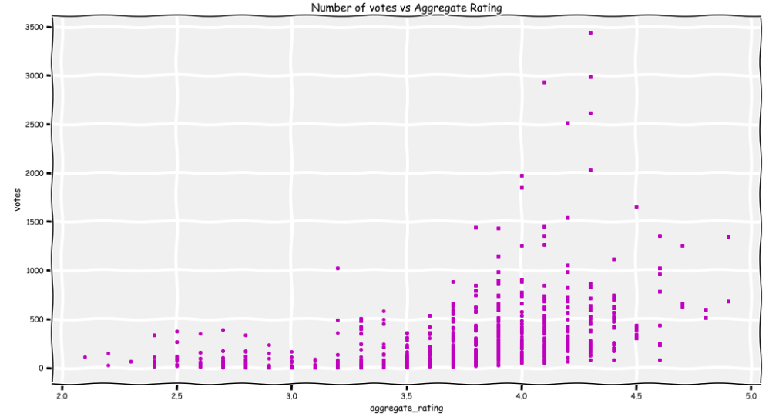
Number of votes vs aggregate_rating
Aggregate_rating between 3.5 and 4.5 has highest number of votes.

Slide 14
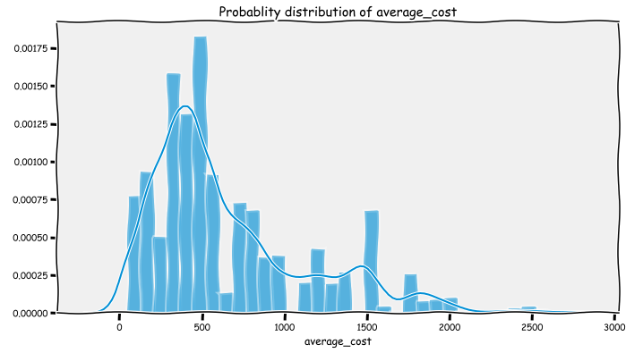
Probablity distribution of average_cost
Most of the restaurants are in the average_cost range of 100 to 1000.

Slide 15
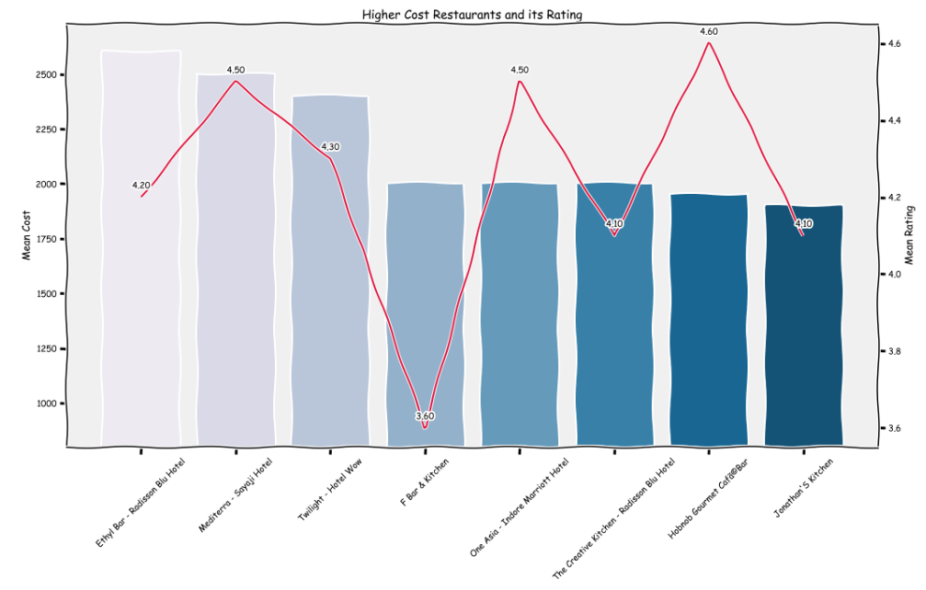
Relation of ratings and high cost restaurants
High cost restaurants have varied mean rating, but generally > 4

Slide 16
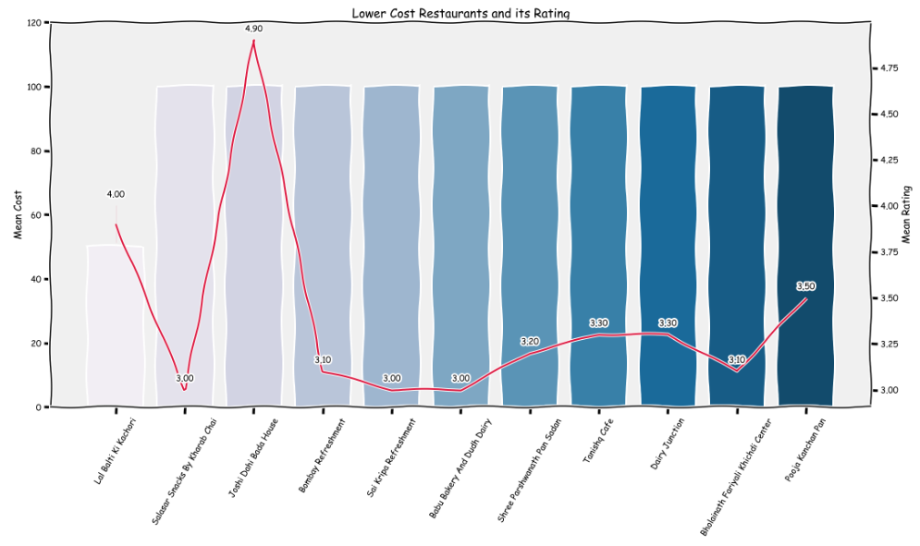
Relation of ratings and low cost restaurants
Low cost restaurants have mean ratings generally around 3.5.

Slide 17
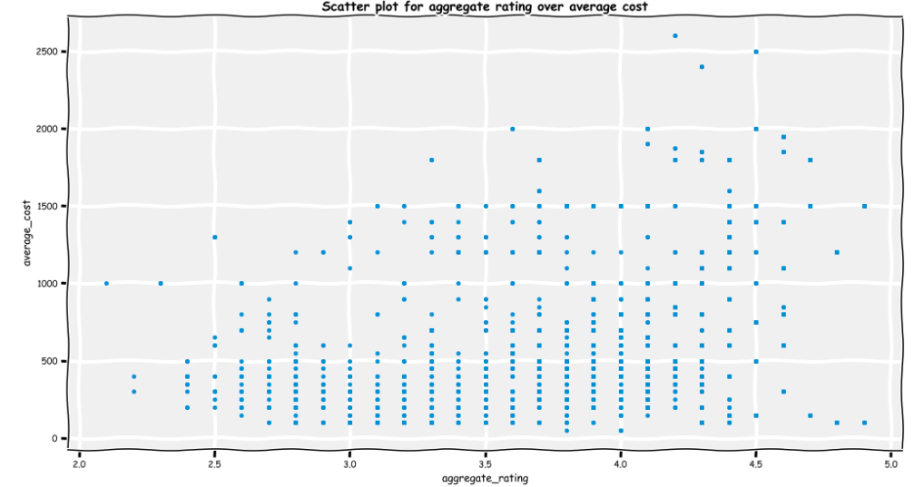
Scatter plot for aggregate rating over average cost
Higher cost restaurants ( > 1500) tends to have higher ratings ( > 4).

Slide 18
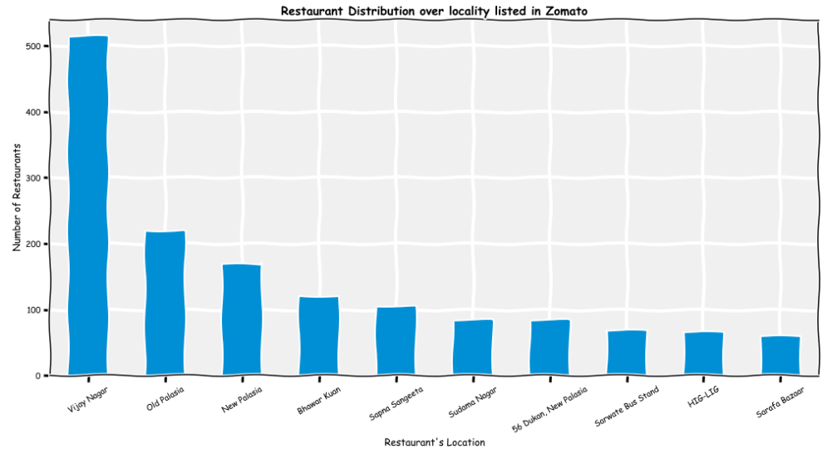
Restaurant Distribution over locality
Vijay Nagar has the highest number of restaurants, followed by Old Palasia and New Palasia

Slide 19
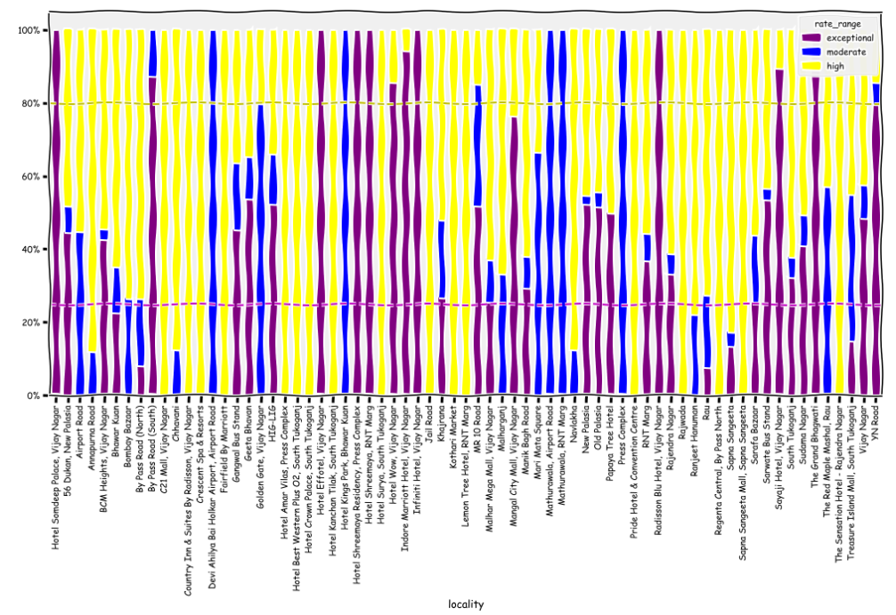
Aggregate Rating per Locality
Again here if you go through each color you will get the hint that.
Vijay Nagar and RNT Marg has highest number of exceptional (4-5) rated restaurants. But, it must also be considered that this localities also has highest number of restaurants.
Devi Ahilyabai Holkar Airport, RNT Marg, Bhawar Kaun and Press Complex has highest number of high (3-4) rated type restaurant in Indore.
Vijay Nagar, Jail Road, South Tukaganj, Kothari Market, Press Complex, Rajwada, Sapna Sangeeta Mall and Rajender Nagar has highest number of moderate (2-3) rated type of restaurants. Localities like Vijay Nagar and Press Complex also has low rated restaurants, because as mentioned above, they have most number of restaurants.
Surprisingly, there are no restaurants rated low (1-2) rated restaurants. This may also be dataset problem, with no low rated restaurant data.

Slide 20
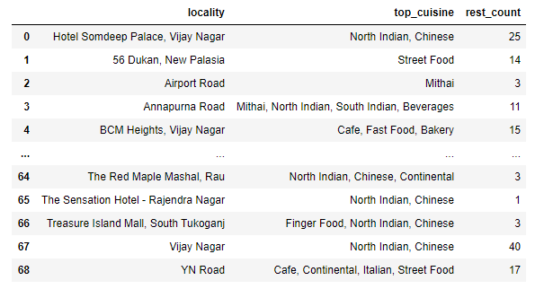
Cuisine trend per Locality
We can see in the above table that many neighbourhoods are characterised by certain type of cuisine.

Slide 21
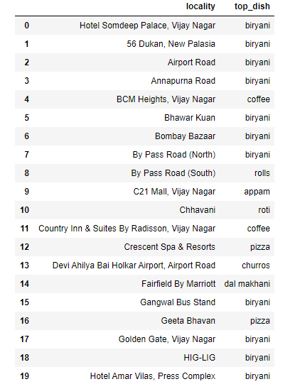
Top Dish liked per Locality
It seems Biryani is the most liked dish in Indore!

Slide 22
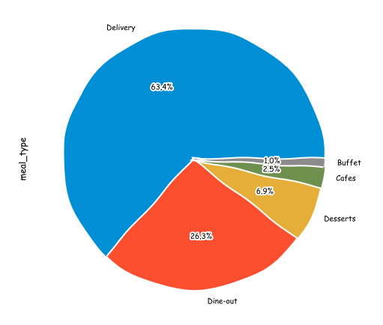
Service types popular in Indore
Majority of restaurants (~>60%) provides an option of home delivery, as almost all restaurants listed on Zomato do provide home delivery.
~26% of the restaurants listed on Zomato provides Dine out option

Slide 23
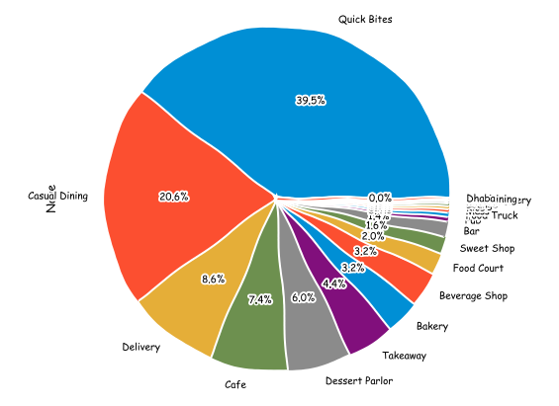
Restaurant Types popular in Indore
Quick Bites is most popular restaurant type in Indore (~ 40%), followed by Causal Dining (~ 21%).

Slide 24
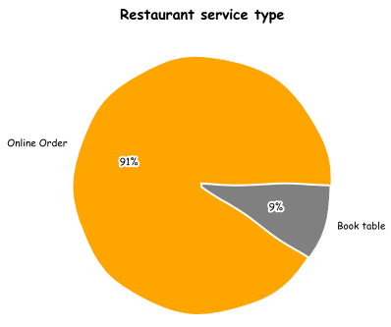
How many restaurants have online order service & book table service?
Its quiet clear that the majority of restaurants in our dataset has online order services but minority with book table service, which is may due to the nature of city or general lifestyle !

Slide 25
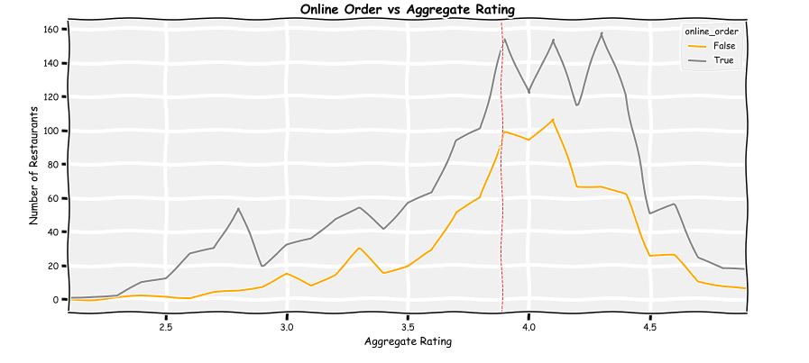
How the online order service affects the restaurant rating?
As we notice from the above chart that having the online order service has some effect on rating the restaurants , such that we can found at the same level of rate there is higher number of restaurants that has online order service especially above the average rate of 3.7.

Slide 26
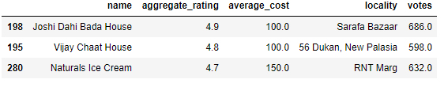
Which are some of the best restaurants providing online order?
Answer:
In Joshi Dahi Bada House at Sarafa Bazaar, you can order online with highest aggregate rating of 4.9 for the cheapest average cost for 2 persons.
Vijay Chaat House and Naturals Ice Cream are at 2nd and 3rd place respectively.

Slide 27
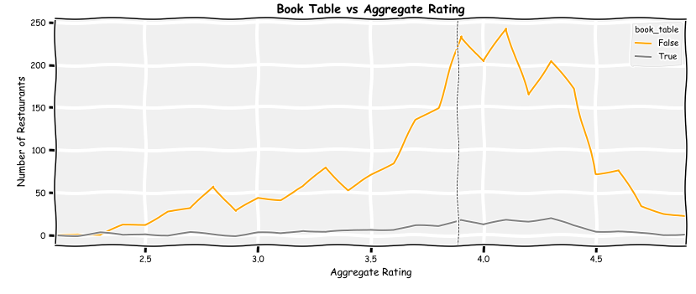
How the book table service affects the restaurant rate?
You can observe here that if your restaurant has no book table service you still have the opportunity to have a similar aggregate rating as other restaurants, that provide this service. Most of the restaurant do not provide this service
Note around 3.8 rating, we notice higher number of restaurants at this rate and provide book_table service

Slide 28
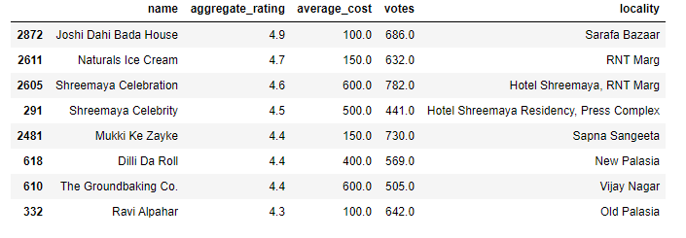
Which are some of the best restaurants providing book table service??
Answer:
Again, in Joshi Dahi Bada House at Sarafa Bazaar, you can book_table with highest aggregate rating of 4.9 for the cheapest average cost for 2 persons.
Naturals Ice Cream and Shreemaya Celebration 2nd and 3rd place respectively.

Slide 29
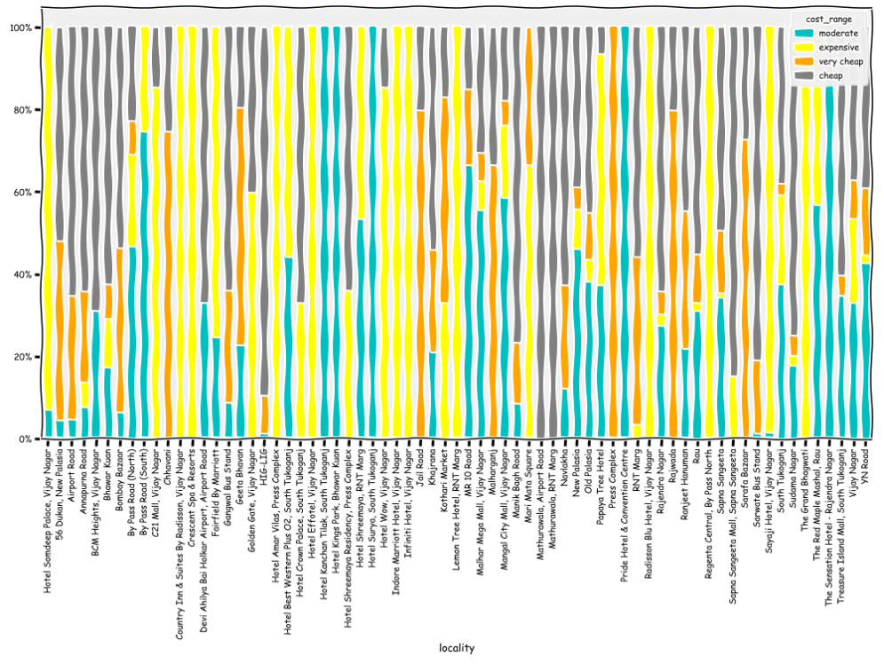
What is the relation between cost and neighbourhood?
So crowded as we have 69 locations, but you can notice the following:
Vijay Nagar, RNT Marg, Crescent Spa & Resorts, Kothari Market, Regenta Central and Mari Mata Square has some of the expensive (1000-3000) restaurants.
South Tukaganj, Bhawar Kuan, By Pass Road (South), The Red Maple Marshal Road and Rajender Nagar has some of the moderately (500-1000) priced restaurants.
HIG-LIG, Mathurawala, Sudama Nagar and Manik Marg Road has some of the cheapest (100-500) restaurants.
Press Complex, Chhavani, Jail Road, Geeta Bhavan, Rajwada and Sarafa Bazaar has some of the very cheap (0-100) restaurants.
Likely certain locations affected by the level of population hence the costing strategy differs

Slide 30
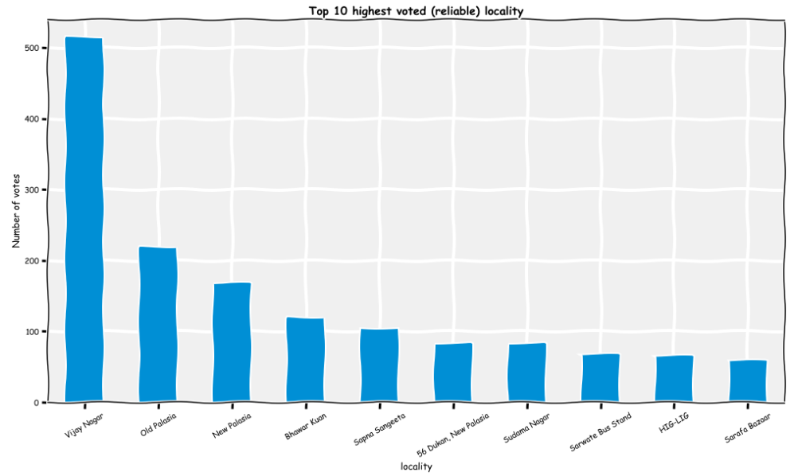
What is the relation between votes and neighbourhood?
Vijay Nagar has the highest number of votes, followed by Old Palasia and New Palasia

Slide 31
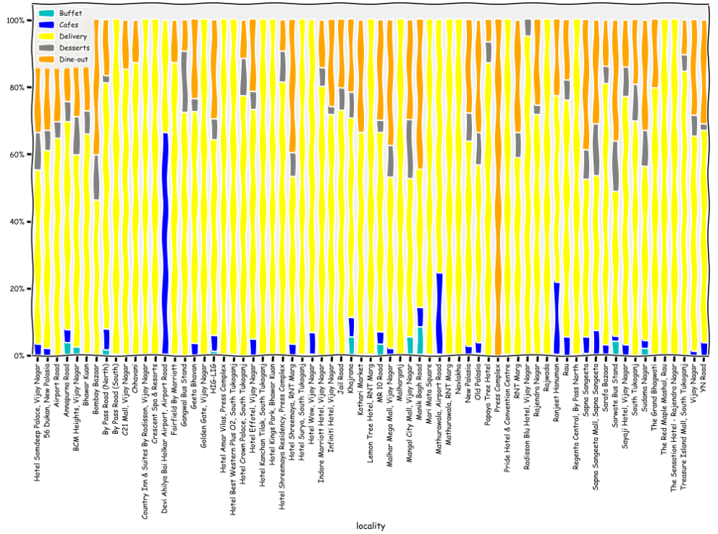
What is the relation between meal_type and locality?
Again here if you go through each color you will get the hint that.
Each locality has preferred meal_type like:
Devi Ahilya Bai Holkar Airport and Mathurawala at Airport Road and Ranjeet Hanuman has higher number of cafes
Red Maple Mashal, RNT Marg, Rajwada, Geeta Bhavan, Navlakha, South Tukaganj has highest number of delivery type restaurant in Indore.
Press Complex, Hotel Shreemaya, Bombay Bazaar, Hotel Somdeep Palace has highest number of dine-out type.
Manik Bhag road, Khajrana, Annapurna road, Sudama Nagar has highest number of Buffer type restaurants.

Slide 32
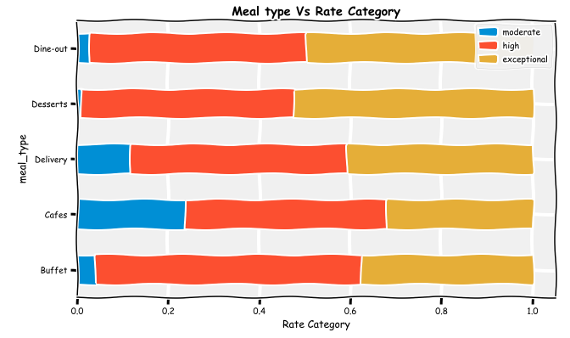
What is the relation between meal type and the rating?
Desserts have highest number of exceptional rate category, and buffet with highest number of high rate category

Slide 33
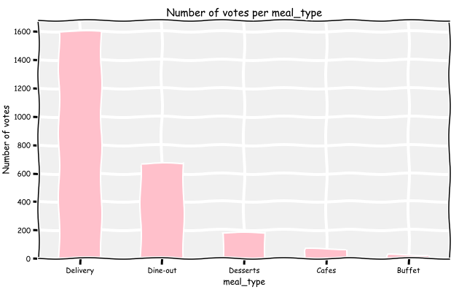
Number of votes per meal_type
Delivery has highest number of votes, followed by dine-out.

Slide 34
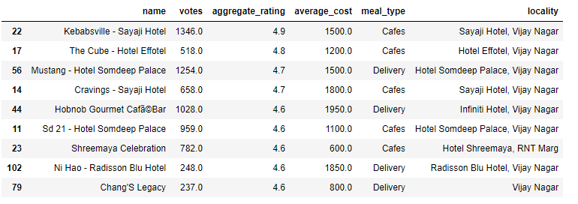
Best rated, most voted restaurants, irrespective of cost
This will be as:
has the high aggregate_rating , > 4.5
has the high number of votes as it will more reliable

Slide 35
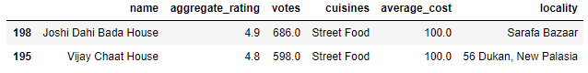
Best restaurants in Indore ?
Joshi Dahi Bada House and Vijay Chaat House are the best overall restaurant in Indore !!

Slide 36
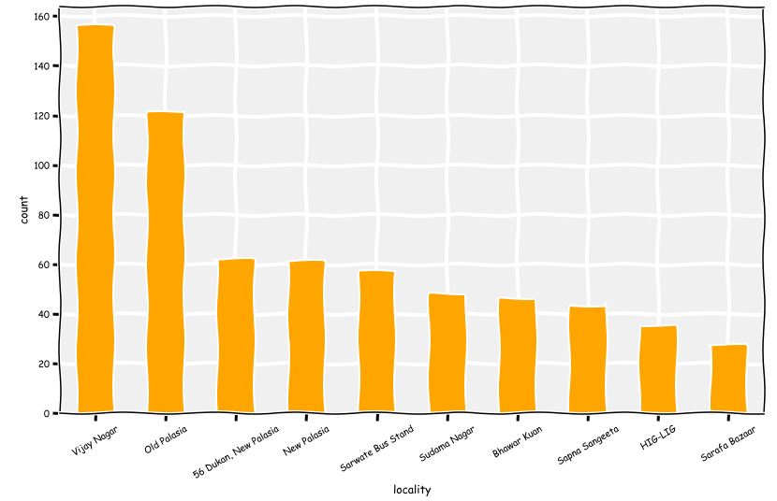
Where can one find the best restaurants in Indore?
Vijay Nagar is again at the top of the list, followed by Old Palasia and New Palasia

Slide 37
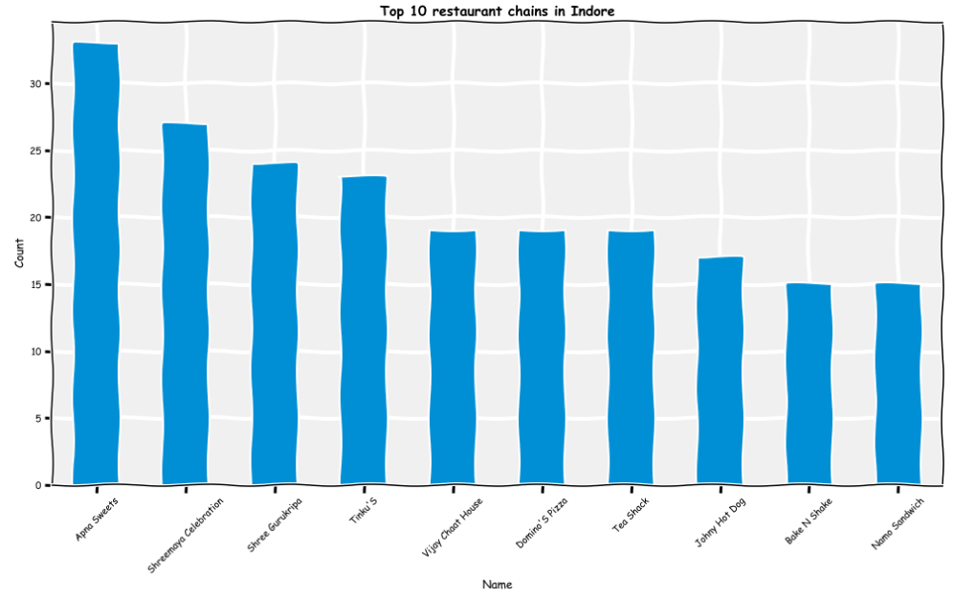
Top 10 restaurant chain in Indore
Some of the top restaurant chains that have decent ratings, votes and cheaper price are Apna Sweets, Shreemaya Celebration, Shree Gurukripa, etc.

Slide 38
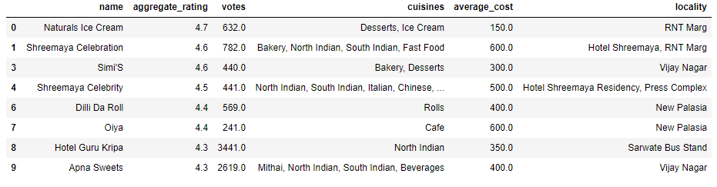
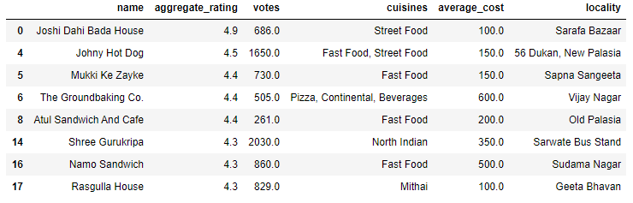
Best dessert parlors in Indore
Best Cafe's in Indore

Slide 39
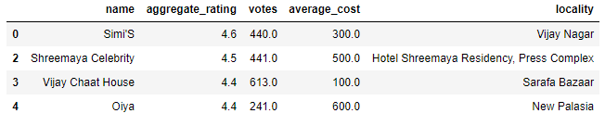
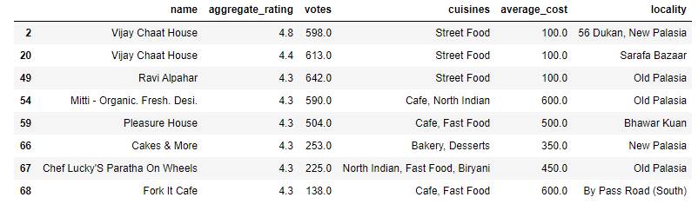
Best bakeries in Indore
Best dine-outs in Indore

Slide 40
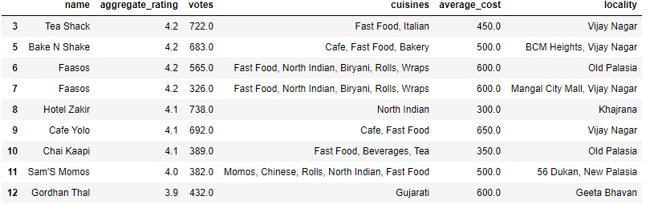
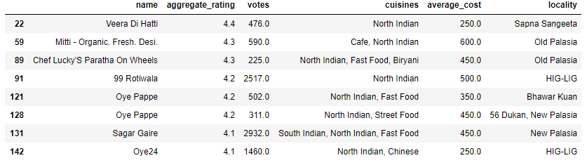
Best Sweet shops in Indore
Best North Indian restaurants in Indore

Slide 41
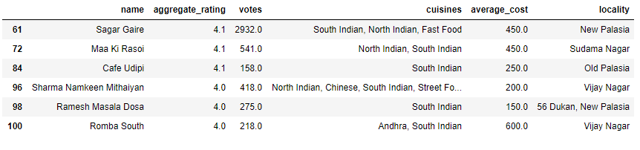
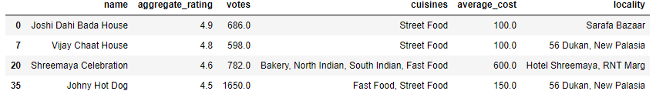
Best South Indian restaurants in Indore
Best Fast- food restaurants in Indore

Slide 42
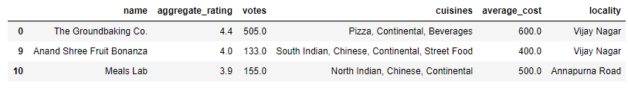
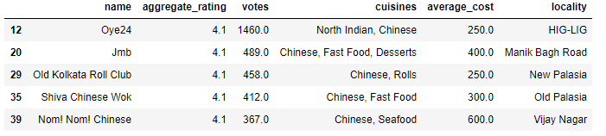
Best Continental restaurants in Indore
Best Chinese restaurants in Indore

Slide 43
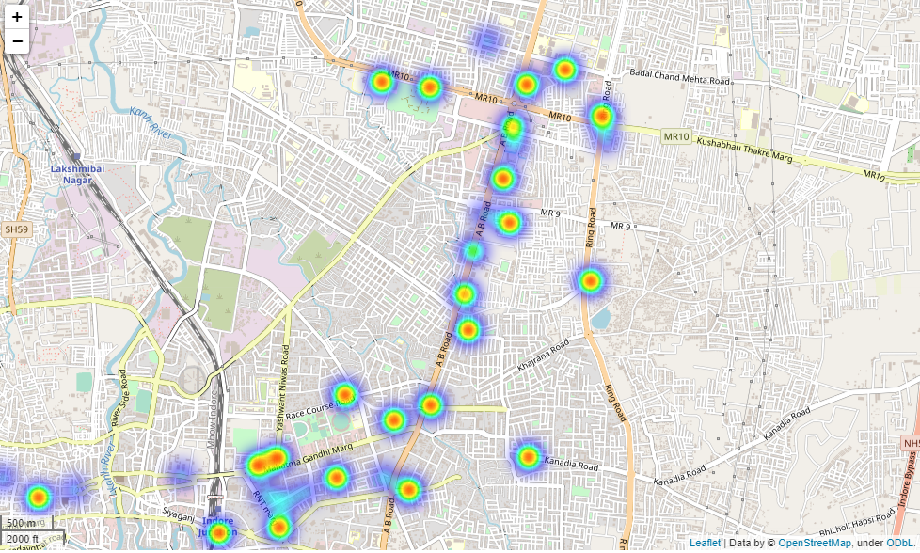
HeatMaps
High dense restaurants localities are redder, while low dense restaurants localities are bluer on the map of Indore city.

Slide 44
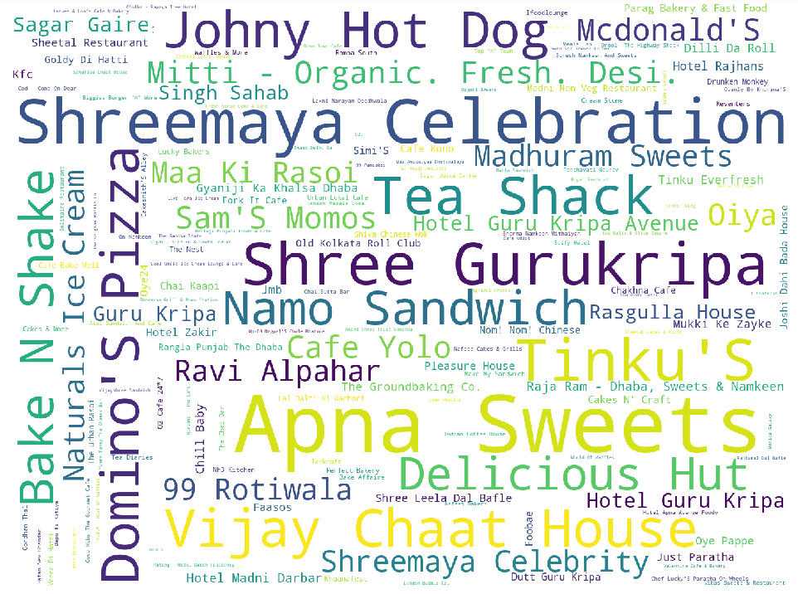
Some of the most famous restaurants in Indore
Word Analysis

Slide 45
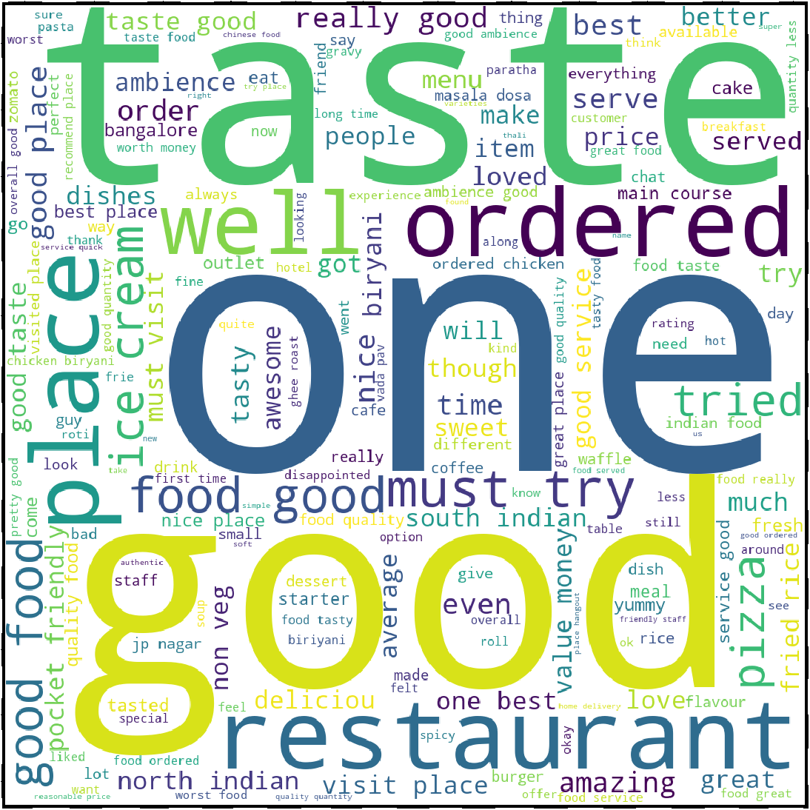
Customer reviews

Slide 46
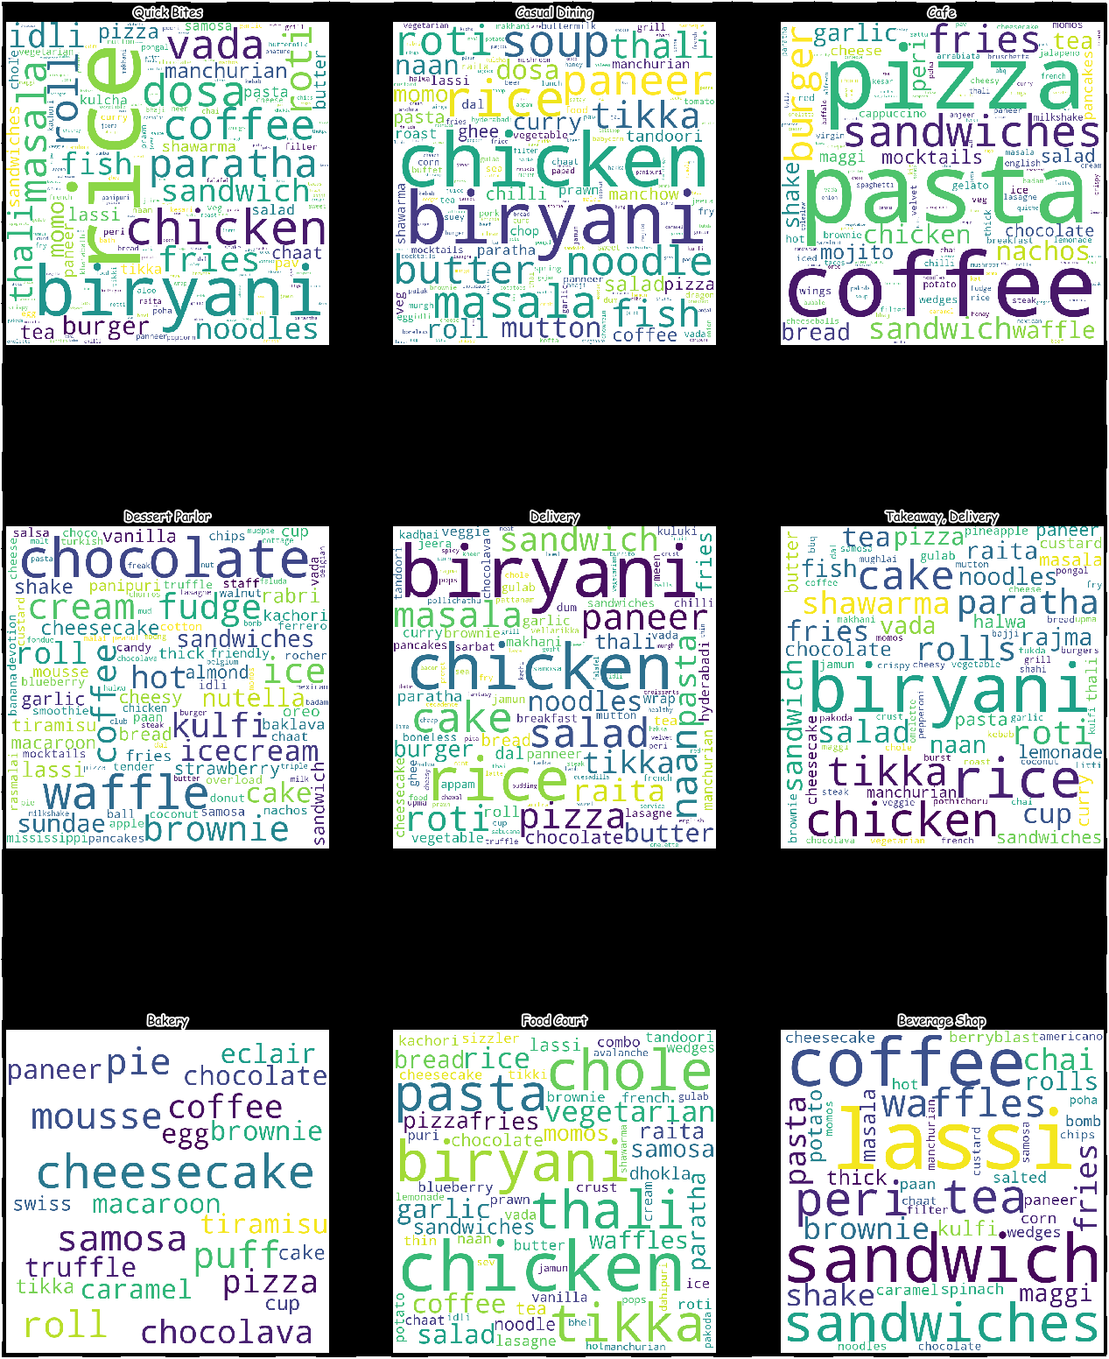
Word Cloud of dish_liked by restaurant_type

Slide 47
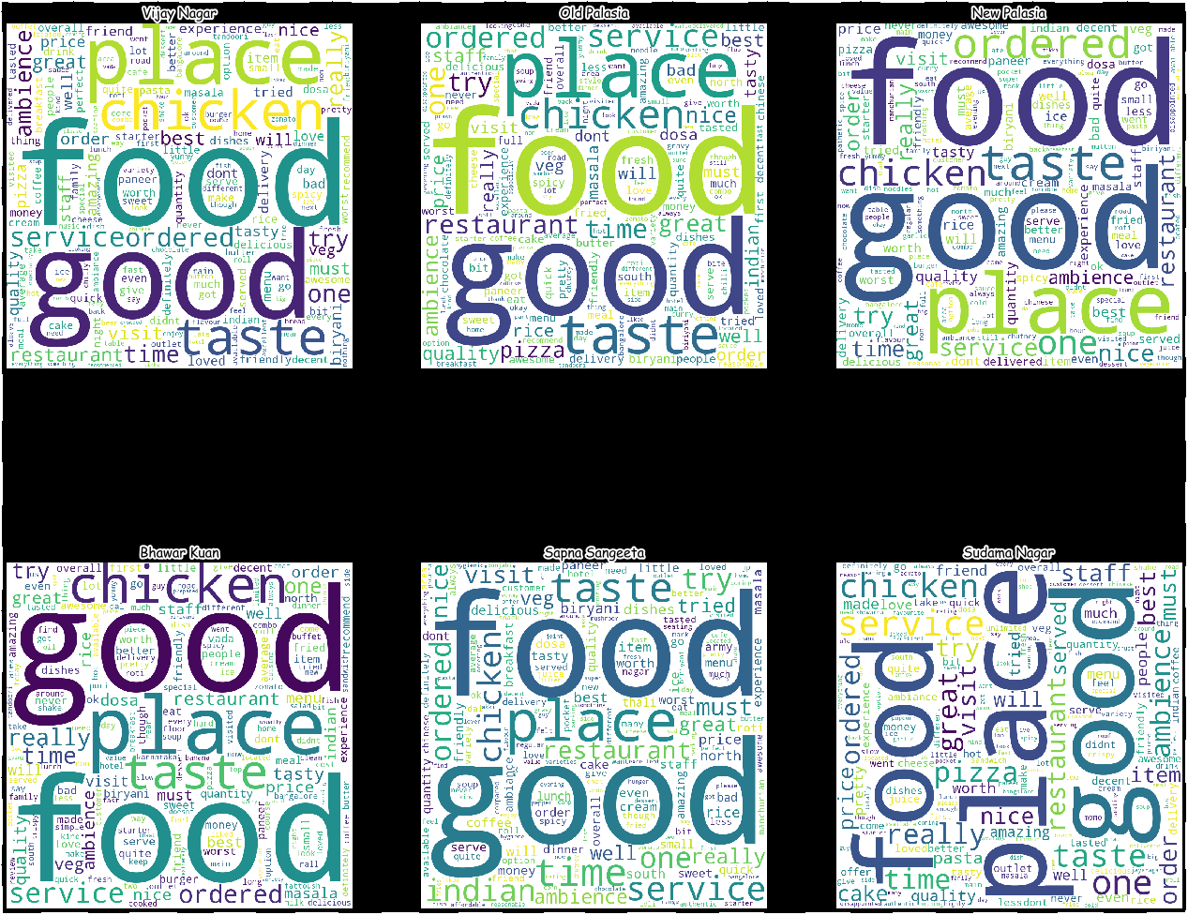
WordCloud of Reviews by locality

Slide 48
Sentiment analysis
Sentiment Analysis of customer reviews on the basis of restaurant type and locality can be found in notebook
Predictive Analytics
Predictive Analytics to predict aggregate_rating and number of votes based on other features can be found in notebook

Slide 49
Technology Stack
Python, Jupyter Notebook
Numpy, Pandas (dataframe)
MatPlotLib (visualizations)
Word Cloud (word analysis)
Folium (HeatMap)
VaderSentiment (sentiment analysis)
SkLearn (predictive analytics)

Slide 50
Future Scope
Web Application development
API development
Cloud deployment
Interactive dynamic visualizations (Plotly)

